Slide 1
STUDY PROJECT
Business Analytics
Student dropout analysis based on previously acquired educational achievements: A case of the University of Portalegre
Izzeldeen Nedal Younis Al Fraijat
Danat Semeneev
Ieva Žube
Pankaj Chettri
Kristaps Eglītis
14.12.2023.
Notes:
Kristaps

Slide 2
Importance of a higher degree
People pursue the path for a higher degree because of:
Materialistic benefits
Socializing
Social pressure
People with a higher degree earn more:
+44% with bachelor’s degree
+91% with master’s or doctoral degree
Governments and educational institutions need to track KPI’s
Notes:
KRISTAPS

Slide 3
KPI’s
Student grade improvement compared to financial support
3x lower dropout rates for students with support
Institutional improvements
40% less dropouts in schools with improvements
Relative changes in student’s grades
Higher the average grade, lower the dropout rate
Notes:
KRISTAPS

Slide 4
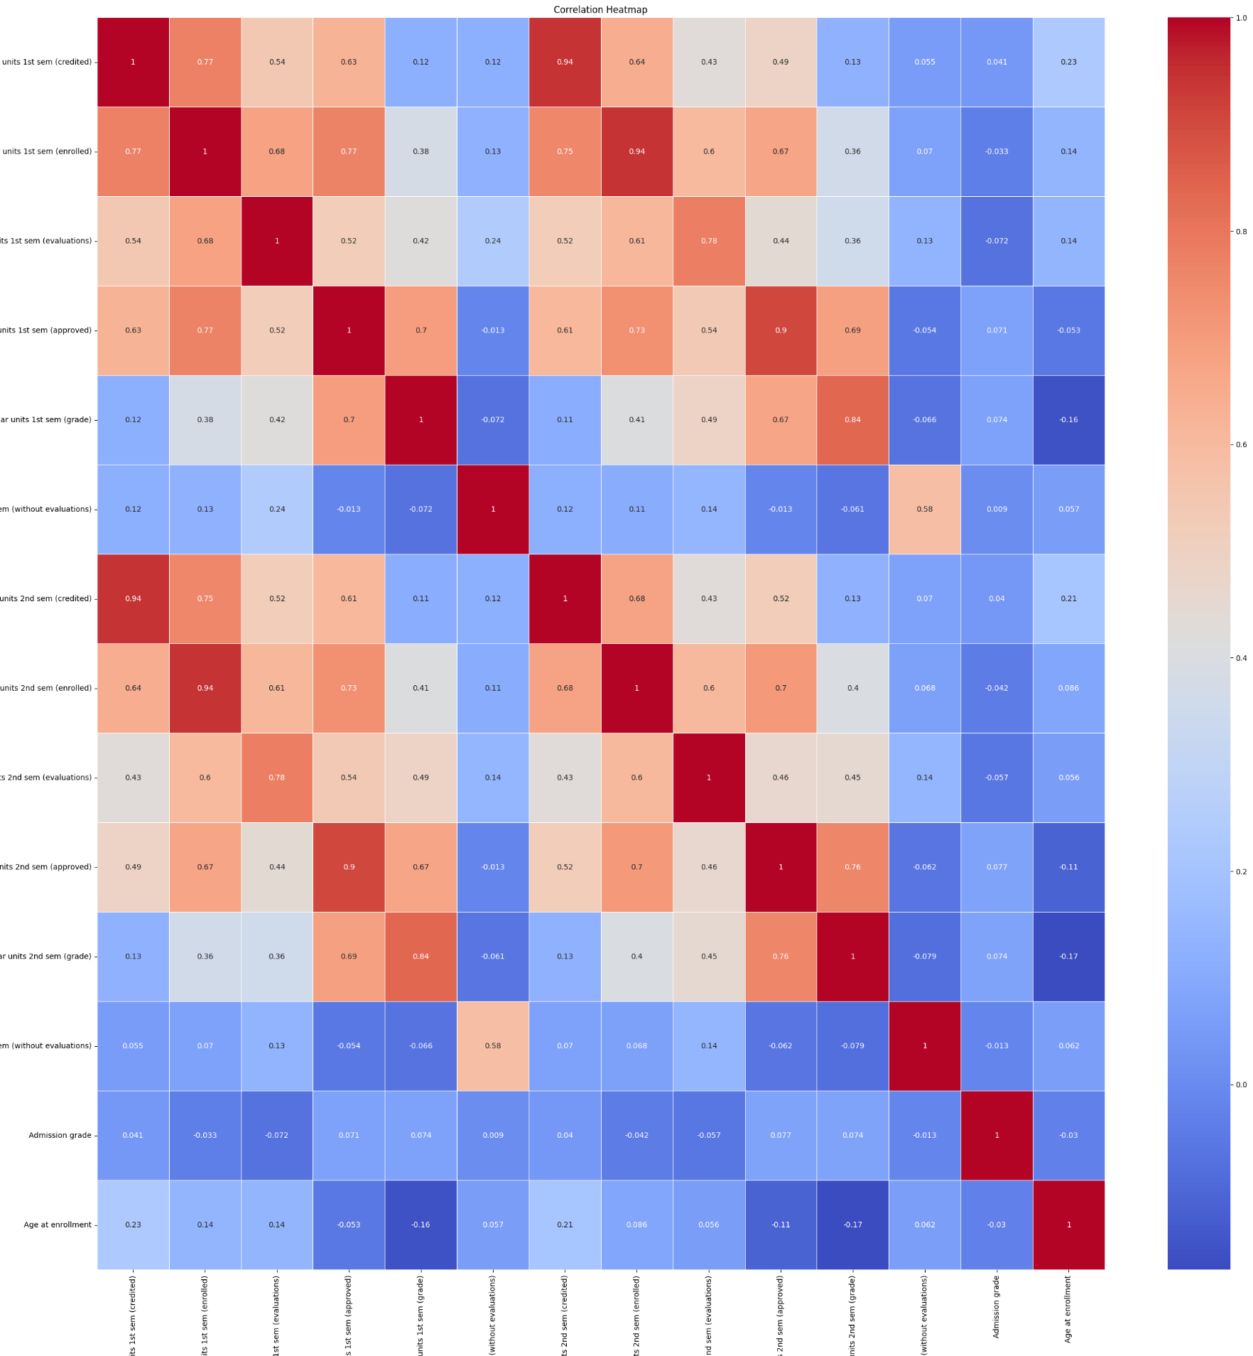
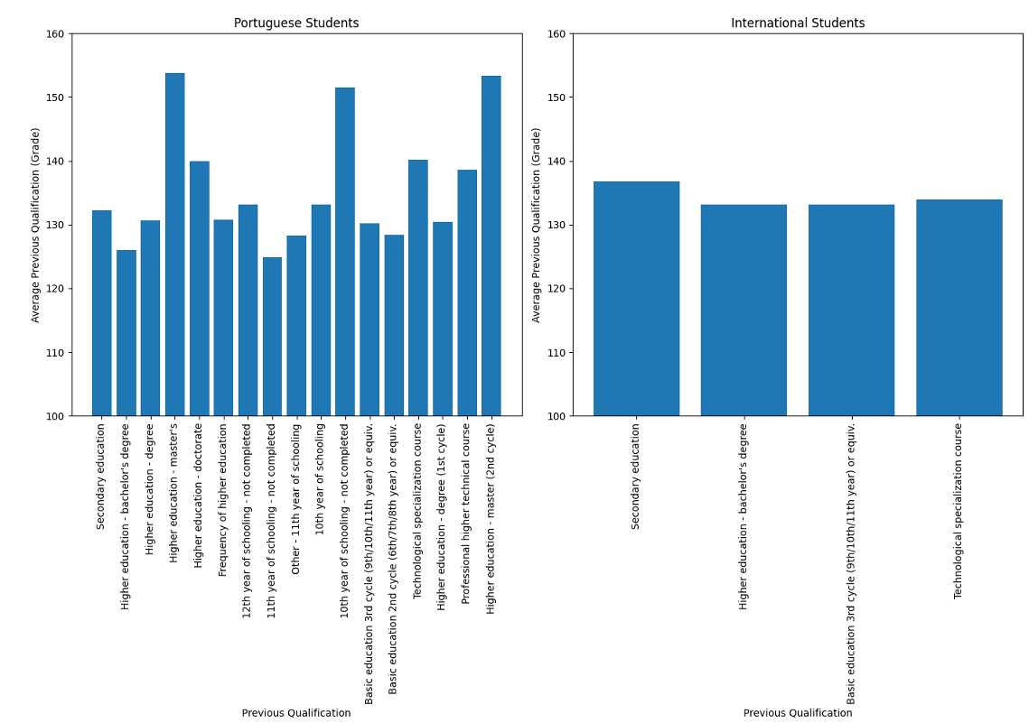
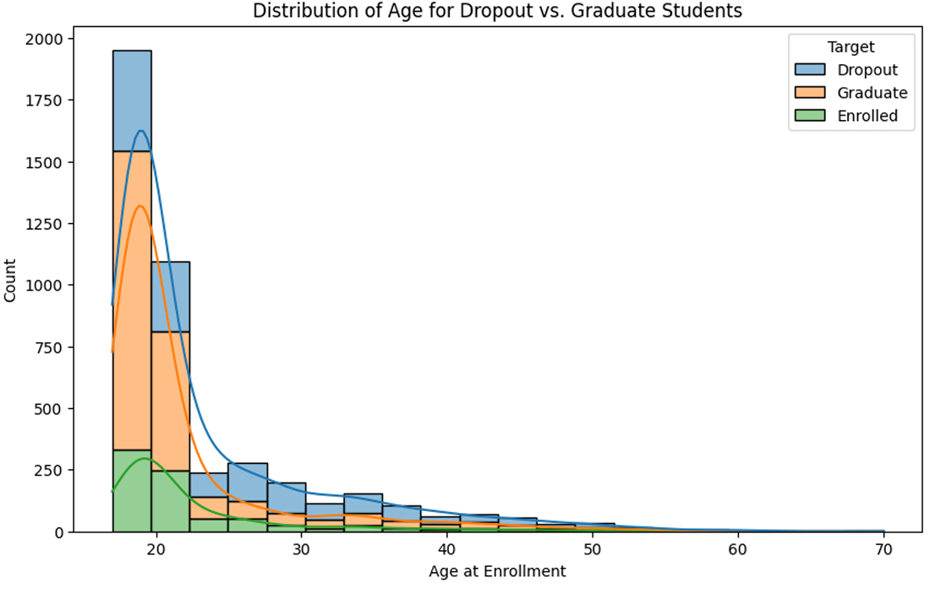
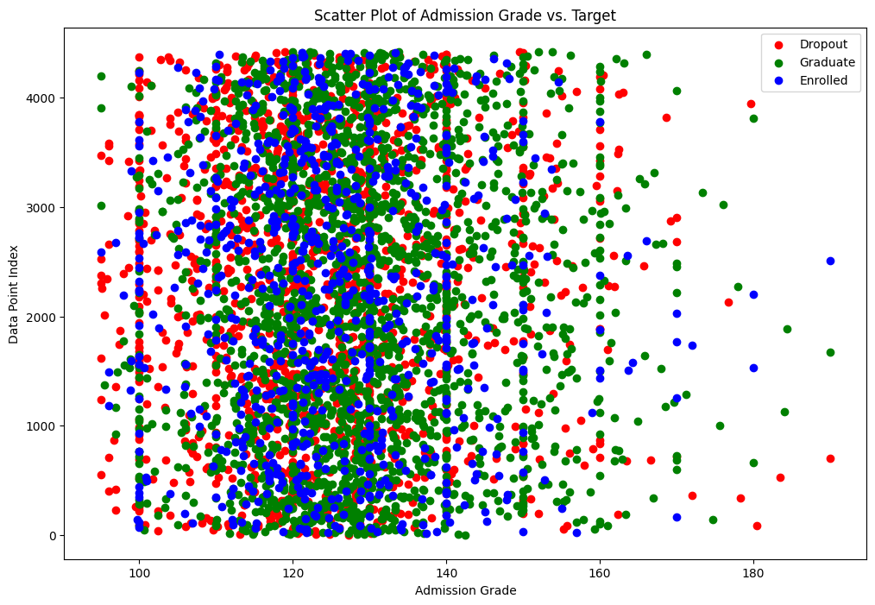
Exploratory Data Analysis
Findings :
Portuguese students subject to high diversification in educational background with 10th year of schooling not completed being one of the three prevalent category
Majority of the target group students fall within the age group of 18-19 years
Academic performance was most likely to continue for the students who done well in 1st semester
Data Limitations :
Delving deep for certain factor analysis was not possible due to limited data availability
Missing Attributes hindered a reliable and comprehensive understanding of student dropout rates
Notes:
Pankaj

Slide 5
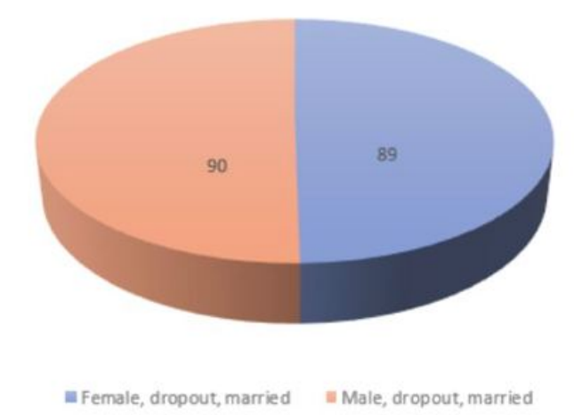
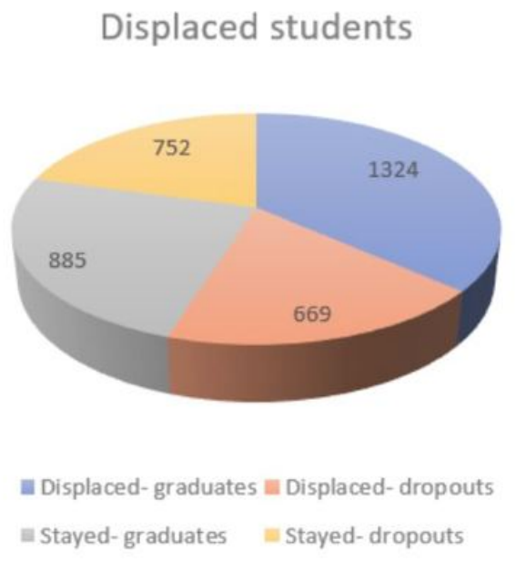
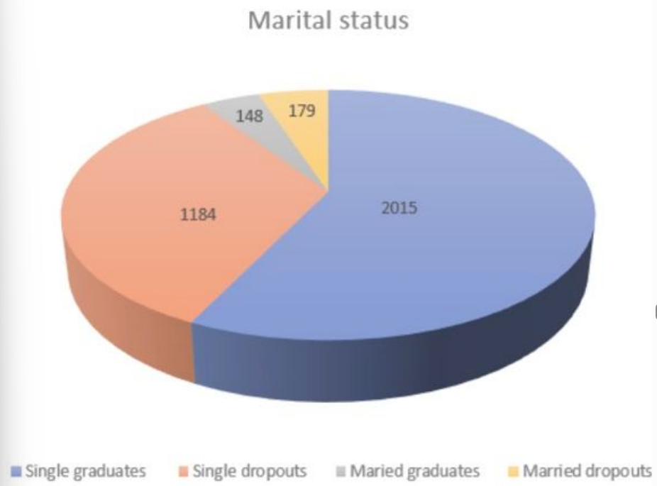
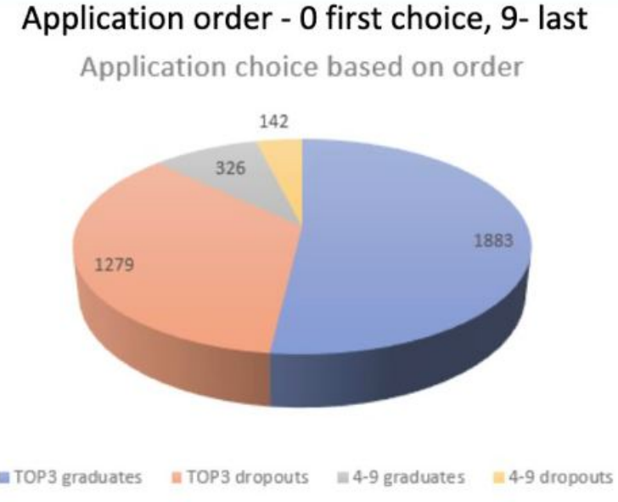
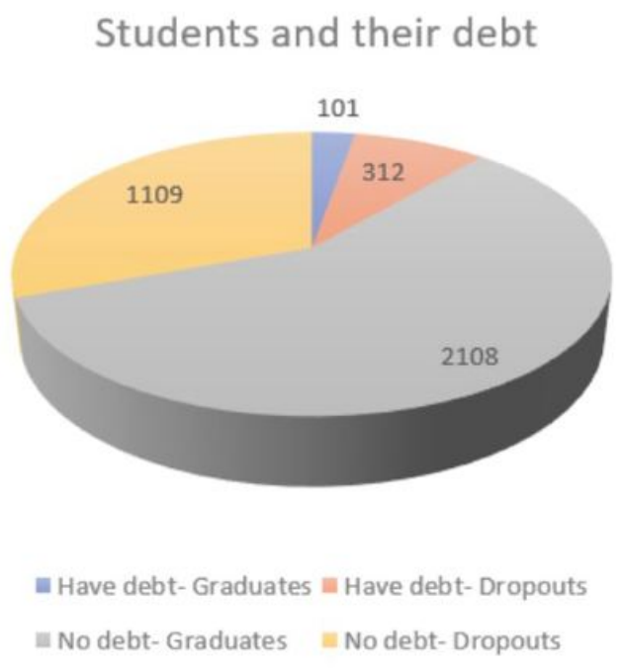
Hypothesis Testing results
First choice program- higher graduation rate
Have a debt - 3x more dropouts
Displaced students - more graduates
Age - less graduates
Marital status married- less graduates
Gender, nationality, pregnancy - doesn’t matter
Notes:
Ieva

Slide 6
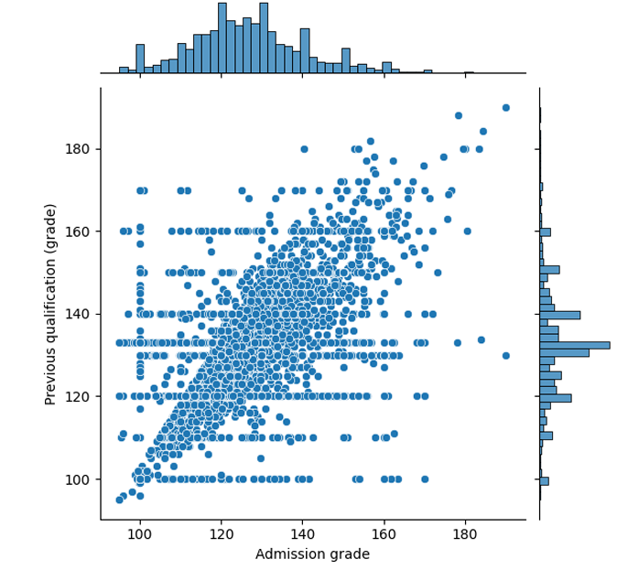
Data Limitations and Implications
For Limitations:
Limited Data on External Factors (e. g. reasons of leave like employment)
Emphasis on Admission Grade
Neglect of Enrollment and Completion Dates
Lack of information on some categorical values like Application type
For Informed Decision- Making Implications
Targeted Intervention : Comprehensive information of the factors beyond the admission grades are crucial to identify and address the dropout cause reliably
Comprehensive Data Collection : Expanding the dataset for including various other factors like enrollment and completion dates, longitudinal data, socioeconomic factors is crucial for making informed decisions.
Notes:
Pankaj

Slide 7











Machine learning: pipeline description
PCA,
Remove Multicorelatity
Permutation & RandomForest Importance
SMOTE augmentation
GBTC
Blender + stacker model
Multivariate Normalization
Isolation Forest
Linear Discriminant Analysis
Linear Regression
Notes:
Danat

Slide 8
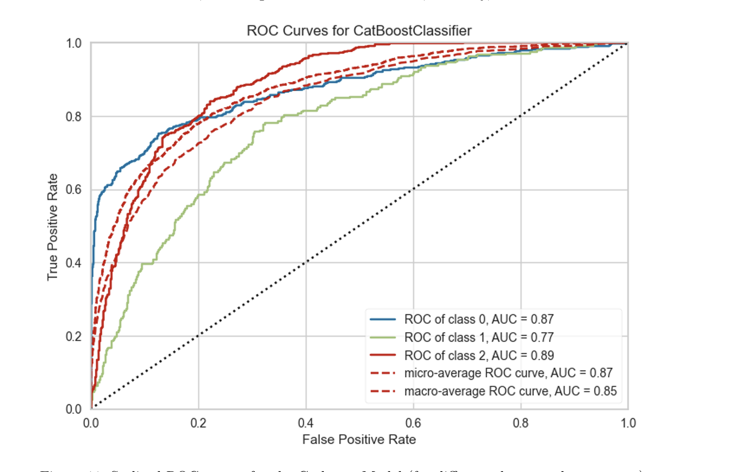
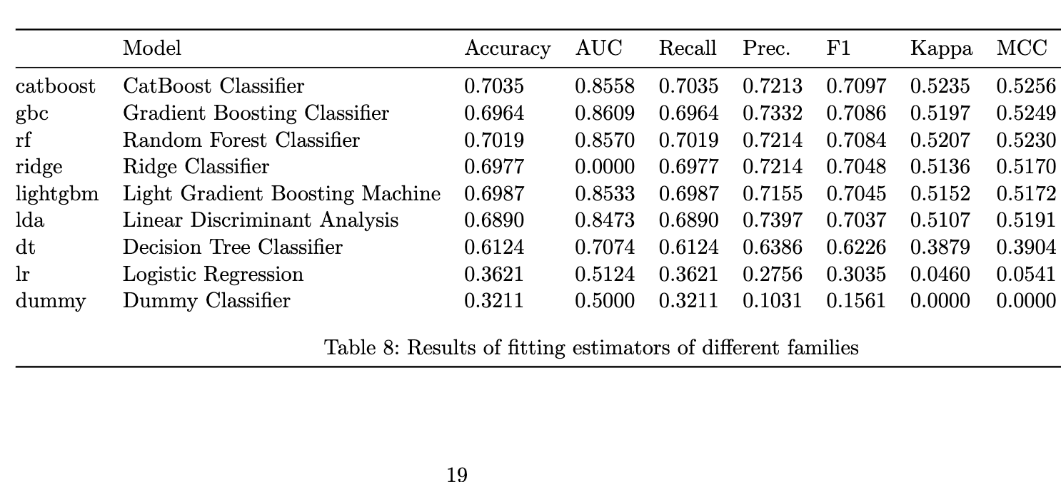
Predictive Analysis: Model Leaderboard
Key metrics: F1 0.71 on
Average, RAUC 0.9 on binary classification.
Best models: CatBoost Classifier, XGBoost, Random Forest Classifier
ROC curve for Graduate/Dropout
ROC curve for Enrolled
Use instructions: early signals for the most likely exodi, drawing attention to more challenging cases
Notes:
Danat

Slide 9
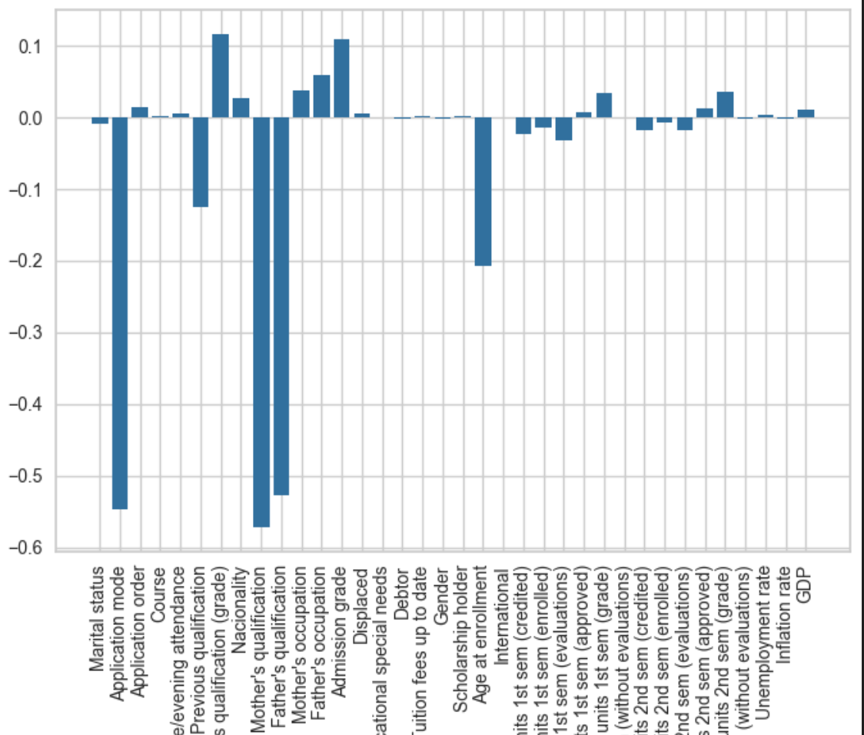
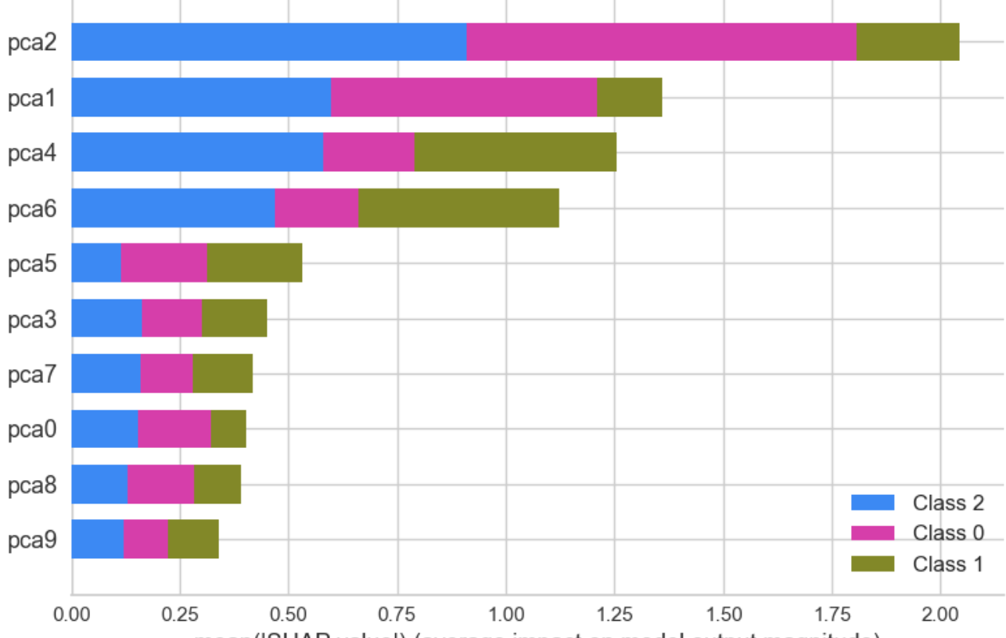
Predictive Analysis: Augmentation and Explanation
Blending improves slightly the model (F1=0.75, AUC 0.93), but stacking with Logistic Regression does not give auxiliary improvement
Using shapley values for components inside blended model, and decomposition coefficients for the features inside components, we can impute the significance of source value in a specific decision

Slide 10



Recommendations
Provide academic support, career guidance
Engage students in university activities
Flexible lecture options
Financial support and emergency ‘Scholarship’ to
Time management education for academic and professional success
Collect feedbacks and continue improving
Notes:
Ieva

Slide 11
Conclusion
Our data analysis highlights the key role of factors from academic support and socioeconomic conditions in keeping the students enrolled. The observed patterns reveal significant stress among students, emphasizing the need for provident measures.
Parental Incentives: Encouraging career growth for parents enhances dedication to children's education.
Financial Assistance: Targeted support during academic struggles is crucial for dropout prevention.
Time Management Education: Emphasizing proper time management is essential, especially for students pursuing second studies.
Communication: Students communicating academic priorities reduces the impact of changes.
Implementing these strategies, informed by data, will reduce dropout rates and improve overall student outcomes. Proactive measures and supportive environments enhance maintaining the education quality.
Notes:
Pankaj (What O-oh) :D

Slide 12
Thank you for the attention!
Questions?

